Slide 1
HOTEL AGGREGATION ANALYSIS WITH POWER BI.
PRESENTED BY – PRAKHAR MISHRA
PROFILE – DATA ANALYST Intern
BATCH – MP-DA-07
PRESENTED TO - @MENTORNEss

Slide 2

INTRODUCTION
A Hotel Aggregator Is Essentially A Hotel Consolidator. These Platforms Bring Together Hotel Listings From Multiple Sources Into One Comprehensive Database.
They Act As Middlemen Between Travelers And Hotels, Providing A Convenient And Efficient Way To Search, Compare, And Book Accommodations.
Hotel Aggregators Can Be Responsible For A Part Of Hotel Room Inventory, Selling It Under A Different Brand Or Taking Over The Entire Hotel’s Inventory……..

Slide 3
Dataset Description:
1. id: Unique identifier for each listing.
2. listing_url: URL of the listing on the hotel aggregator platform.
3. scrape_id: Identifier for the data scraping event.
4. last_scraped: Date of the last data scrape.
5. source: Source of the listing information.
6. name: Name of the listing.
7. description: Description of the listing.
8. neighborhood_overview: Overview of the neighborhood where the listing is located.
9. picture_url: URL of the listing's picture.
10. host_id: Unique identifier for the host.
11. ... (and many more columns capturing details about hosts, location, property type, room details,amenities, pricing, availability, reviews, and other relevant information)

Slide 4
PROJECT OBJECTIVES:
1. Geographical Insights:
- Visualize the distribution of listings on a map to identify popular neighborhoods.
- Explore the geographical concentration of listings and host locations.
2. Pricing and Availability Analysis:
- Analyze pricing trends based on property types, room types, and accommodation capacity.
- Investigate the availability of listings over time and identify peak periods.
3. Host Performance:
- Evaluate host characteristics, including superhost status, response times, and verification methods.
- Explore correlations between host attributes and listing performance.
4. Review Scores and Guest Satisfaction:
- Examine review scores and their impact on overall listing performance.
- Identify areas for improvement based on specific review categories.
5. Property Type and Room Analysis:
- Analyse the distribution of property types and room types.
- Explore trends in the popularity of specific accommodation setups.

Slide 5
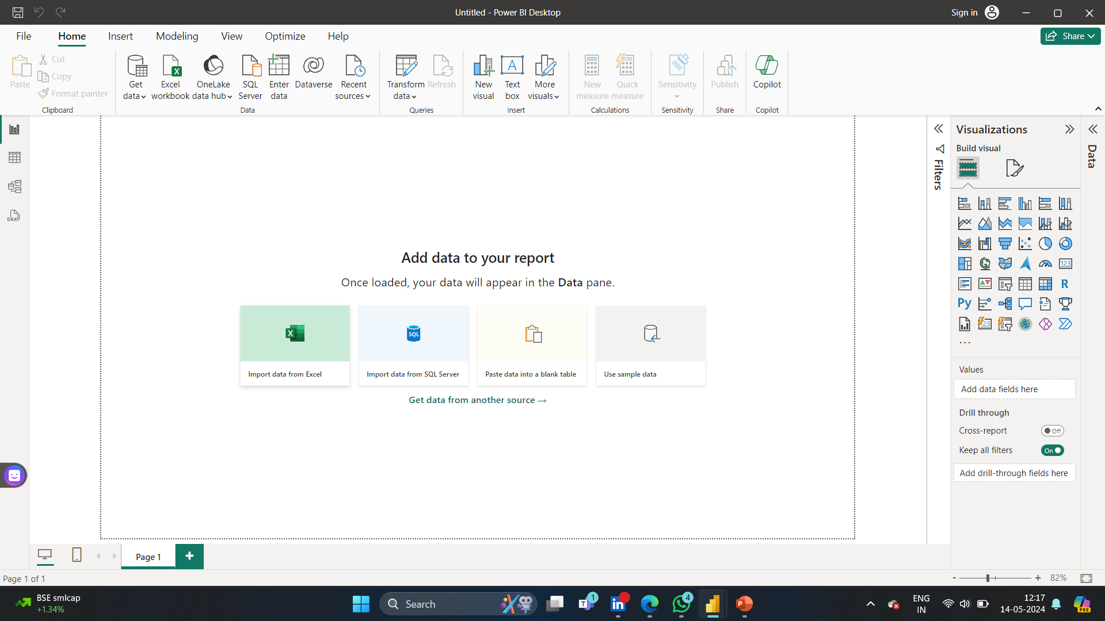



1. IMPORT DATA FROM EXCEl..

Slide 6
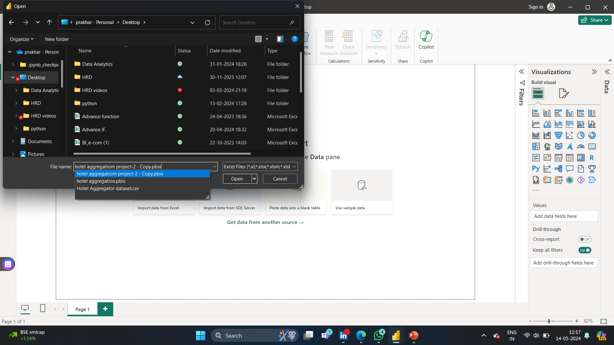
2. Select The Excel File Of Hotel Aggregation Dataset.

Slide 7
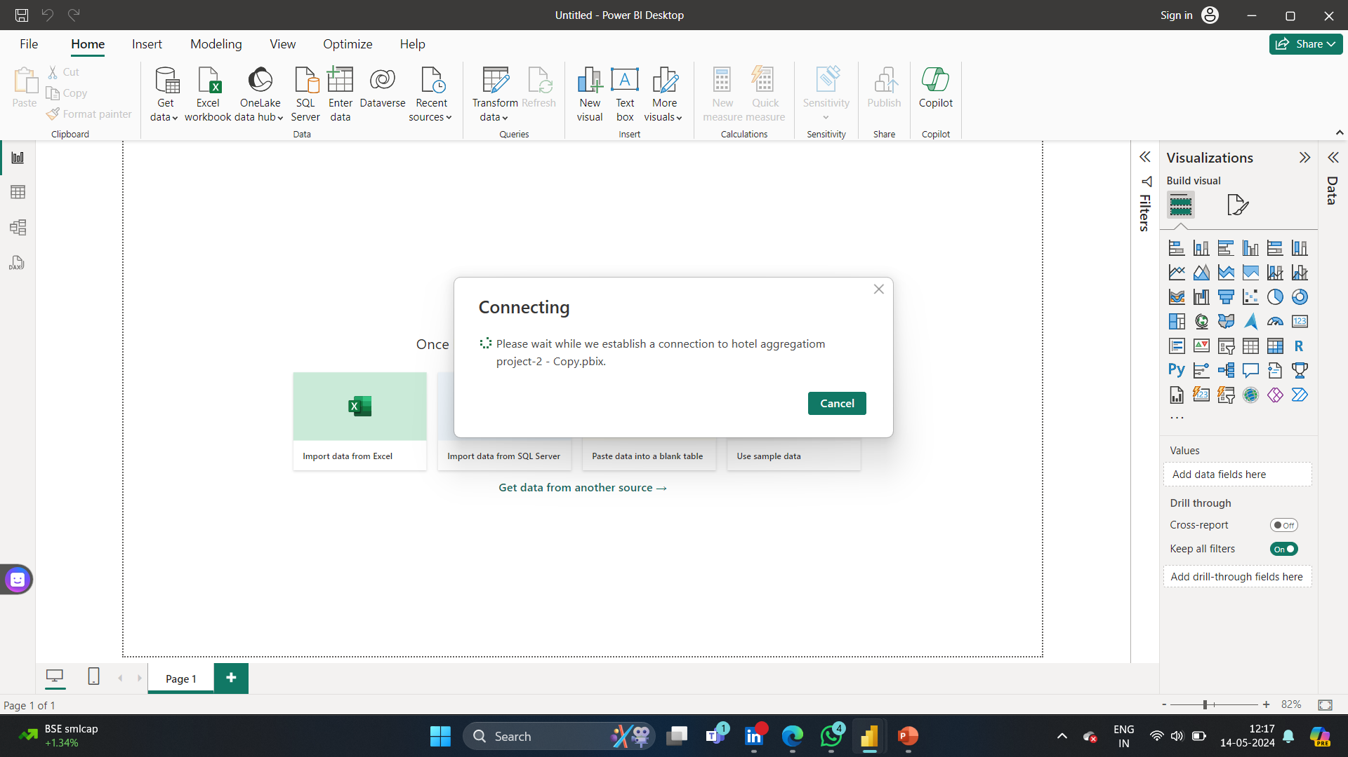
3. Transform And Load The Data….

Slide 8
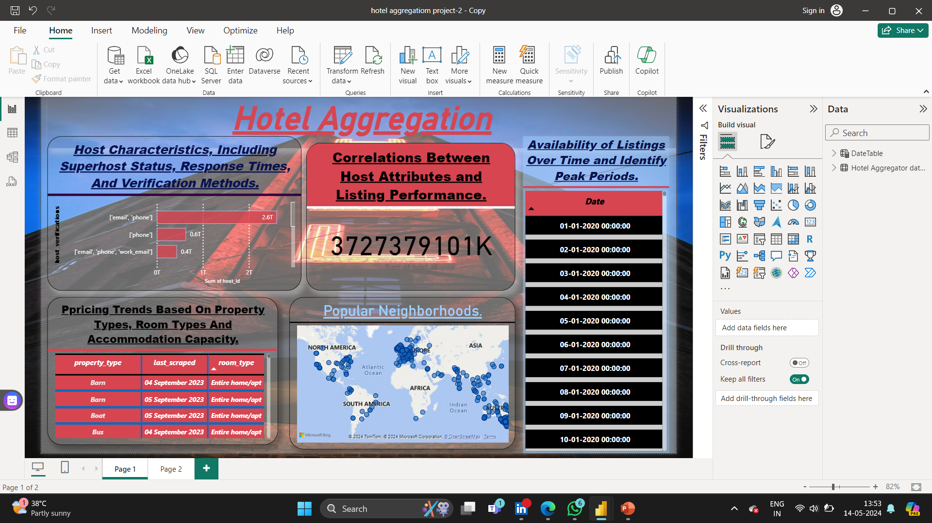
Interactive Power Bi Dashboards Illustrating Geographical Distribution, Pricing Trends And Host Characteristics… ….

Slide 9
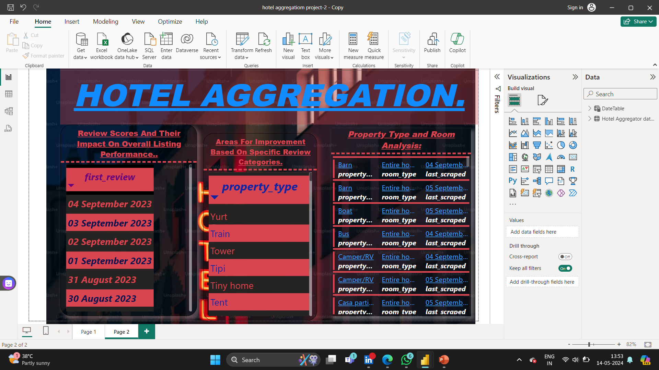
Reports On Availability Patterns, Property And Room Preferences,Review Score , And Factors Influencing Guest… Satisfaction…

Slide 10


